Slide 1

Provider Update: March 2025

Slide 2

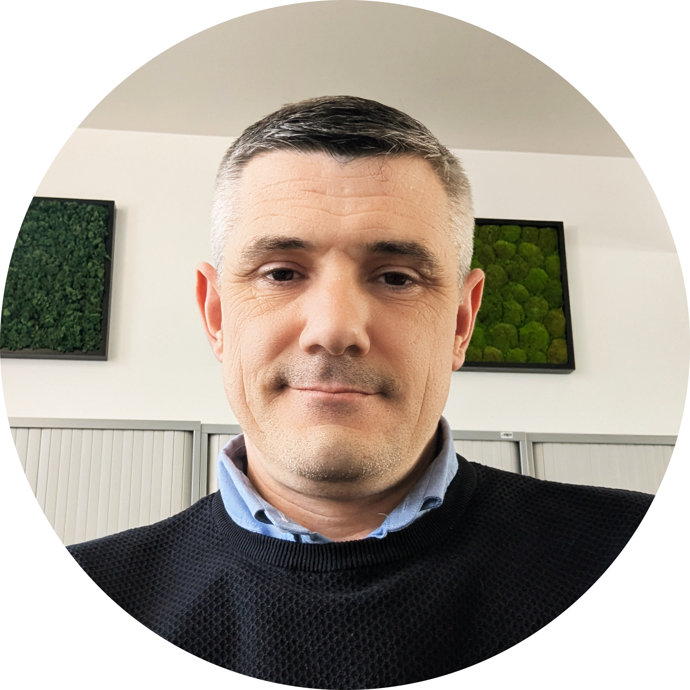
Welcome to the webinar
What we will cover during the session:
Welcome
Meet the panel
Meet your Subject Officer
Qualification Development: update and reminder
Your regional representative: FAQs
Tom Leahy
Subject Officer
T Level Building Services Engineering for Construction
Notes:
Welcome to the webinar for the Building Services Engineering T Level, It is great to have so many of you in attendance. We’re building something special in the development the GEN 2 T level ensuring we shape the next generation of building services engineering talent. In this session we will meet the panel, you will get to learn more about the new T Level subject officer. We will provide important qualification development updates and discuss centre frequently asked question with our regional representative for T Levels

Slide 3



Meet the panel
Tom Leahy
Subject Officer
thomas.leahy@eduqas.co.uk
Chauvan Harding
T Levels Regional Representative, Eduqas
tlevels@eduqas.co.uk
Julie Rees
Qualification Development Officer, Eduqas
Julie.Rees@eduqas.co.uk
Joe Wilson
Head of Work Based Learning and VTQ Delivery, Eduqas
Joe.Wilson@eduqas.co.uk

Slide 4
Meet your Subject Officer
-
Tom Leahy, Subject Officer for T Level
Building Services Engineering for Construction
I'm on hand to provide support and
guidance
Contact me today as you prepare to deliver the new T Level
thomas.leahy@eduqas.co.uk
Tom Leahy
Subject Officer
T Level Building Services Engineering for Construction
Notes:
My name is Tom Leahy, I am the Subject Officer for the T Level Building Services Engineering qualification.
I started my career in Building Services in the late 1990s where I served a four year Plumbing apprenticeship working on both commercial and domestic properties gaining the knowledge and practical experience in all aspects of Plumbing and construction. After a number of years working on various project I returned to education to expand my knowledge of building services. During my career as a plumber I gained significant experience of the training and development of company apprentices. this would spark my next career move. In 2009 I moved into Further Education achieving teaching, assessing and quality assurance qualifications. This role allowed me to train the next generation of construction and building services professionals, something I have been doing ever since. Over the last 4 years I have continued to teach as well as rising to the position of Head of Construction which involved me supporting the College, department and staff in the training of learners across all disciplines.
Other experience I have gained along the way includes:
Electrical
Renewable energy
Qualification development
External quality assurance
Textbook writing.
I will be on hand to support providers in the delivery of this exciting new qualification. If you have any questions, please do not hesitate to contact me today via the email on your screen. I am looking forward working together to ensure you can deliver this new qualification confidently and equip your learners with the skills and knowledge they need to succeed.
Next up we will have updates from your qualification development team, Julie Rees and Joe Wilson, followed by an update from Chauvan Harding, our regional representative, Thank you

Slide 5

Qualification Development:
Update and reminder

Slide 6

Introduction to our Qualification Development Team
Julie Rees – Qualification Development Officer
With 18 years of experience in the education sector with WJEC Eduqas, Julie manages the development of a portfolio of new and reformed qualifications to meet external stakeholder needs.
Julie has a detailed understanding of qualifications policy, assessment, design rules, quality standards and process requirements, which enables her to successfully co-ordinate and monitor production of the draft specification, SAMs and assessment strategy in line with Eduqas’ policies and processes.
Joe Wilson – Head of Work Based Learning and VTQ Delivery
Joe has 8 years of experience within the education sector, first as a lecturer before working for another awarding organisation, gaining experience in T Levels, as well as Level 3, 4 and 5 vocational qualification development before joining Eduqas. Joe has previously worked on T Levels in a number of roles in both the development and live delivery of a range of T Level qualifications across Waves 1, 2 and 4.
Notes:
Thank you for the introduction, Tom.
My name is Julie Rees, and as Tom noted, I’m a Qualifications Development Officer at WJEC Eduqas.
I’ve been working on the development of the next-generation T Level In Building Services Engineering alongside my colleague, Joe Wilson.
Together, we bring extensive experience in the education sector, particularly in developing vocational qualifications.
Our main goal is to ensure that the specification and sample assessment materials that we have developed fully meet the needs of providers, students, and employers.

Slide 7


Timeline
August 2024 |  | Development began
Late spring 2025 |  | Final specification and specimen assessment materials to be published
September 2025 |  | First teaching
Summer 2026 |  | First assessment opportunity for the Core component (exams and ESP)
Summer 2027 |  | First assessment opportunity for the OS components
Notes:
Our development process began in August 2024.
We reviewed the gen 1 qualification , gathering valuable feedback from employers and providers on all aspects of the qualification, taking into consideration the breadth and depth of content, manageability for providers and rigor of the qualification, to ensure that the qualification remains fit for purpose, meets the needs of industry standards, and prepares students for work.
We are excited to share the final specification and sample assessment materials following our final approval milestone, in late Spring,
in preparation for first teaching in September this year.
The first assessment opportunity for the core examinations and employer set project, will be in summer 26,
and the first opportunity for the assessment of the occupational specialism components,
will be the following year in summer 27.

Slide 8


Changes from Gen 1
The following changes are being made to the core component:
Specification
Format updated to provide clarity and enhance readability
Content reviewed and updated
Core Exams
Retained the structure of Gen 1 with an updated set of questions for Gen 2
Employer Set Project
Task 1.4 removed the requirement for learners to ‘present’ the information verbally
Task 2.1 - Group Collaboration - opportunity to discuss the response to the brief with peers
Notes:
We have refined the format of the specification to enhance clarity and readability.
As part of this update, we reviewed the breadth and depth of content, ensuring a balance between manageability for providers and the rigor required for the qualification.
One key improvement is the consolidation of duplicated content within the Core,
to avoid repetition and to support a more holistic teaching approach.
As a result of last year’s consultation, we have retained the core examination structure from Gen 1
while introducing a refreshed set of questions.
Feedback indicated no major concerns with the Employer-Set Project.
However, we have made some refinements to improve clarity and usability based on consultation insights.
Some feedback suggested that information was occasionally confusing, and expectations were not always clear for students and providers.
To address this, we have restructured the materials by breaking down the project brief and tasks into distinct sections.
Key information is now highlighted under specific headers for easier navigation.
The original requirement of Task 1.4 ,for providers to observe, video record, and upload presentation evidence for each student was found to be overly burdensome.
Additionally, students found the presentation element challenging, as verbal presentations are not a typical industry practice for conveying technical information.
To address this:
We have removed the requirement for students to verbally present their findings. Instead, students will have the opportunity to demonstrate their communication skills and technical knowledge in Task 2.1 – Group Collaboration. This task allows them to engage in discussions with peers,
better reflecting real-life industry scenarios where collaboration and problem-solving are key.
This concludes the summary of updates to the core component,
I’ll now hand over to my colleague, Joe, who will share updates to the occupational specialisms.

Slide 9

Reminder: Changes from Gen 1
The following changes are being made to the Occupational Specialisms:
the Electrical and Electronic Equipment Engineering OS is being removed
the Ventilation OS is being removed; as a result, students will not be able to undertake the combination of Heating engineering and Ventilation OS. Heating is not being removed
Air conditioning engineering and Refrigeration engineering is still available as a combination
Intention for the Heating Engineering and Plumbing Engineering OS will be fully combined into one Heating and Plumbing Engineering OS
a new Low Carbon Heating Technician as a new Occupational Specialism is being introduced from September 2026
Notes:
Joe

Slide 10


Occupational Specialisms
As well their core exams and Employer-Set Project, learners will choose one of the following options to complete:
Electrotechnical engineering
Protection systems engineering
Gas engineering
Plumbing and Heating engineering
Low Carbon Heating engineering*
Air conditioning engineering and Refrigeration engineering
Notes:
6 options available to students
To support centres, we will be releasing a new set of updated sample assessment materials, relevant for each occupational specialism, in line with any changes made to the content, as well as addressing any feedback raised during consultation and validation, as well as a brand new set of SAM's for the combined plumbing and heating OS
We will also be releasing an updated set of GSEM materials for the OS's, again, in line with the changes made to the sample assessments.
Low carbon heating technician materials will come later, as this is a newly added OS, but these will be available before the first assessment of OS in September 2027.

Slide 11

Get Involved
We currently have a number of vacancies available if you would like to be involved with the ongoing development and delivery of the T Level in Building Services Engineering, including:
Chair of Examiners
Principle Examiner
Reviser
Visit the Eduqas website for more information on the roles available.
Employers are also central to both the design and delivery of T Levels, and we will be engaging with industry throughout the development and delivery period.
For more about how you can play a role in supporting the development and delivery of T Levels, please contact us at tlevels@eduqas.co.uk
Notes:
REGIONAL SUPPORT CHAUVAN

Slide 12
Regional Support that you can rely on
Chauvan Harding, Regional Representative, Eduqas

Slide 13

Regional Support you can rely on
Support, when and where you need it
Experienced former teachers who understand the challenges
We operate across England
Available to help you deliver our qualifications with confidence
Access support for free online or in-person at a time and place that suits you
Your Regional Representative
Chauvan Harding
TLevels@eduqas.co.uk

Slide 14
Top FAQs
Qualification Development
When will the draft specification be available?
Our Qualification Development Team is working at pace to develop the new specification and are working alongside IfATE to ensure it is approved by the end of the spring term. To ensure you receive the latest information, please subscribe to our mailing list.
Centre Approval
What is the process to become an approved centre to deliver T levels by Eduqas? We are currently finalising our approval process and further information will be communicated shortly, however, if you have any urgent queries, please contact our Centre Support Team via centres@wjec.co.uk

Slide 15
Top FAQs
Resources
What resources will be available to support the delivery of the new T level? Will there be resources tailored for learners?
You’ll have access to an extensive range of digital learning and teaching resources to help you with the planning, delivery, and assessment of the new T Level in Building Services Engineering from September 2025.
Our subject experts and resources team will make sure that each and every resource is designed to help you get the most out of your teaching and learning experience, and will include schemes of work, worksheets, multiple choice questions, and more.
We’ll keep you updated with further information on the full range of resources as soon as more information becomes available. If in the meantime, you have any queries please do contact the team via TLevels@eduqas.co.uk

Slide 16
Thank you

Slide 17





eduqas.co.uk/tlevels
Tlevels@eduqas.co.uk
linkedin.com/eduqas
facebook.com/eduqas
x.com/eduqas

